Slide 1
Danish Star and Angel Ornaments

Slide 2
Danish Star Angel
4 strips of fabric (cut them 2 ½ inches x 18 inches and fold right sides together and stitch ¼ inch seam allowance. Turn them right sides out and press with the seam at the top.
Tweezers are helpful
Needle and floss for hanger
7-inch square fabric for dress
27 inches 1 ½ inch wired ribbon
10 inches gold lamé binding for arms
24 inches wired star garland for hanger
3 inches wired star garland for halo
1 double holed wooden bead
Tacky glue
Wooden stick

Slide 3
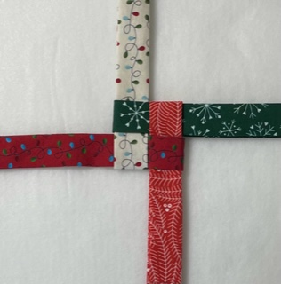
Lay out the four strips as shown.
The strips are woven around each other.
Tighten the strips so that they are snug in the center.

Slide 4
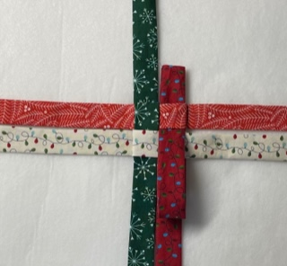
Beginning at the right side, fold the top strip over the center to the left.
Working COUNTERCLOCKWISE continue to fold the next two top strips over the center over the center.
At the last strip, insert the strip end into the loop above it.
Pull the strip through.

Slide 5
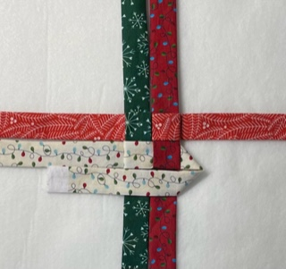
Beginning at the middle right, turn the bottom strip under creating a 90-degree angle as shown.
Next, lay the same strip across the middle creating a triangle.

Slide 6
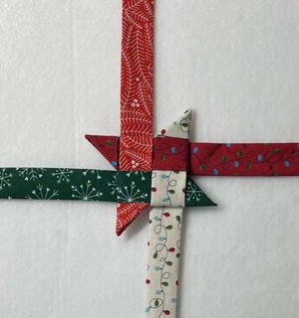
Trim the strip about 1 ¼ inches from the triangle point.
Fold the strip up to form a point.
Now tuck the extra fabric into the strip underneath.
Turn the whole unit clockwise and repeat until you have 4 points.

Slide 7
Now that you have 4 points, turn the entire unit upsidedown.
You will repeat the previous steps for these four strips.
Then you will have 8 points.

Slide 8
You should have all the points done.
Add a hanger using a needle and some floss just at the space between any two points.
Admire your star!

Slide 9
Fold the 7-inch square for the angel’s dress in half and then again. Put some glue in the bottom hole of the bead(the larger of the holes). Use the wooden stick to insert the fabric into the bead.
Gently remove the stick as to not remove the fabric.
Twist the 3-inch piece of star garland into a halo with a stem. Place a drop of glue on the end. Insert the stem of the halo into the small hole at the top of the bead.

Slide 10
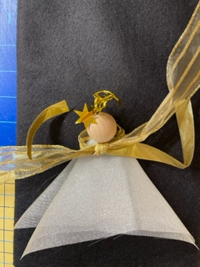
Lay the angel face down across the 1 ½ inch ribbon. Bring the ribbon to the back and make a single loop. You may fold the ribbon at the front if you wish.
Lay the 10-inch piece of gold binding across the loop that you just made. These will be the angel’s arms. Tie the ribbon around the binding.

Slide 11
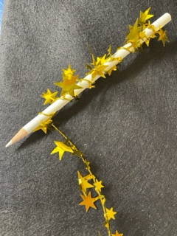
Tie a bow with the ribbon to create the angel’s “wings”. You may trim the tails however you like.
Wrap the 24-inch piece of star garland around the pencil to make it spiral. This will be the hanger for your angel.

Slide 12
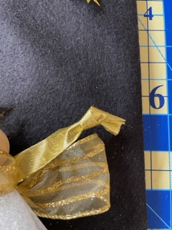
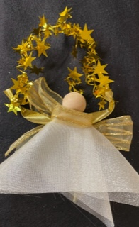
Tie a loose knot at the end of each arm.
Insert the ends of the star garland into each “hand” of the angel and wrap it around to secure it.
You may need to stretch the garland a bit to do this.
Admire your angel!

