Slide 1
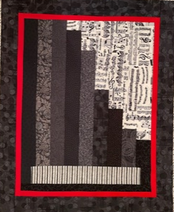
Jazz Piano
©2021 fonzibuglepatterns

Slide 2
Supplies:
9 assorted black/ darker grey fat quarters for the piano ranging medium to dark
1 fat quarter for the background
1 2 ¼ x 11 ½ strip for keys (try to mimic a keyboard)
½ yard for inner borders and binding
¼ yard for outer borders
22 x 25 piece batting
22 x 25 piece for backing
*basic sewing supplies: machine, thread to match, scissors, pins, rotary cutter and mat and ruler, etc.

Slide 3
Step One:
**Read all directions before beginning this project. All seam allowances are ¼”.
Layout the fat quarters and decide your arrangement for the piano. Keep in mind that the longest strips will be on the left and the shortest on the right. (I used the darker blacks for strips 1 and 9 so as to frame the piano and keys.)
The strip for the keys should mimic a keyboard. A stripe or checkerboard are nice but it is YOUR piano. Perhaps you have another plan?

Slide 4
Step Two: It is time to cut!
# strips | Piano strips | Background strips
3 | 2 x 15 1/2 | NONE
1 | 2 x 14 1/2 | 2 x 1 1/2
1 | 2 x 12 1/2 | 2 x 3 1/2
1 | 2 x 8 1/2 | 2 x 7 1/2
1 | 2 x 6 1/2 | 2 x 9 1/2
1 | 2 x 4 1/2 | 2 x 11 1/2
1 | 2 x 3 1/2 | 2 x 12 1/2

Slide 5
Step Two (cont):
keyboard | your choice
1 | 2 ½ x 11 ½ **
sides of keys | black
2 | 1 ½ x 2 ½
bottom edge of piano | black
1 | 1 ¼ x 14**

Slide 6
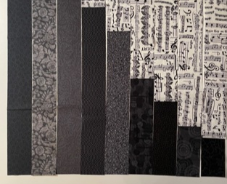
Step Three:
Layout the strips as shown below.

Slide 7
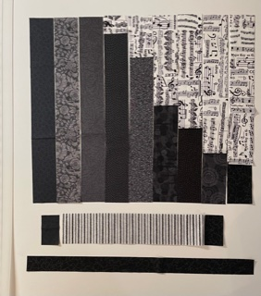
Step Three (cont.):
2. Sew the background to the strips 4 - 9 first. Press toward the black or grey strip.
3. Sew the strips together left to right and press seams in one direction.
4. Measure your piano. You may need to adjust the keyboard strip a bit.**

Slide 8
Step Three (cont.):
5. Sew the 1 ½ x 2 ½ black pieces to edge of keyboard strip. Press away from the keyboard strip.
6. Sew the keyboard to the body of the piano. Press away from piano body.
7. Sew the piano edge to the bottom of the piano body. Press away from the piano body.

Slide 9
Step Four:
1. Measure the length and width of your piano and cut and sew on the borders. I used a 1 inch strip for inner border (½ finished) and a 2 inch strip for the outer borders (1 ¾ finished). You may choose a different width.
2. Layer the quilt top, batting and backing and quilt as desired.
3. Bind the quilt using your favorite method.

Slide 10
ENJOY YOUR PIANO!

